Slide 1
Fetus and neonate
Dr. Tania Warnakulasuriya
Department of Physiology

Slide 2
At the end of the lecture
You should be able to
Describe the growth of the fetus
Describe the structure of the fetal circulation
Describe physiological adaptation to hypoxia
Outline the changes in the circulation and respiration after birth
Outline the postnatal maturation of organs

Slide 3
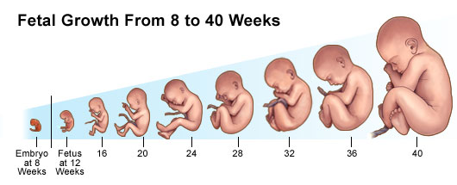
Foetal growth
The length of the fetus is proportional to the gestational age.
Fetus gains weight mainly in the last trimester.
Fat deposition starts after the 28th week.
Growth depends on genetic factors , maternal factors and the function of the placenta.
The normal birth weight 2.5-3kg

Slide 4
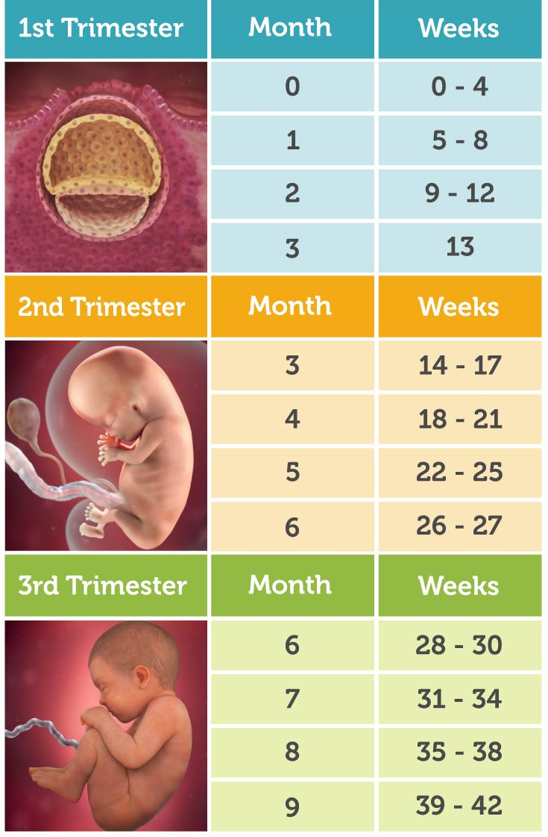
Organ systems
Organs develop in the first trimester.
In the 2nd and 3rd trimester
enlarge in size
Functional development

Slide 5
Fetal nutrition
Fertilization to implantation – maternal genital tract
Implantation to ~8 weeks – Trophoblastic digestion of decidua
1st week onwards – Placenta

Slide 6
Metabolism
Mainly use glucose.
High capability to store fat and proteins.
Iron from the uterine endometrium is used to synthesize the early red cells.
Iron is stored in the liver during the last 4 weeks of gestation and used after birth for erythropoiesis.

Slide 7
Erythropoiesis
Red blood cells
Yolk sac - 3rd week
Liver – 6th week
Spleen & BM – 3rd month

Slide 8
Red blood cells
Hb ~18g/dl
Increased erythropoietin levels due to the hypoxic state.
Erythropoietin formed by the liver.
HbF 2α2γ - higher affinity for O₂
(P₅₀-18-20mmHg)
Facilitate movement of O₂ from the maternal circulation to the fetal circulation.

Slide 9
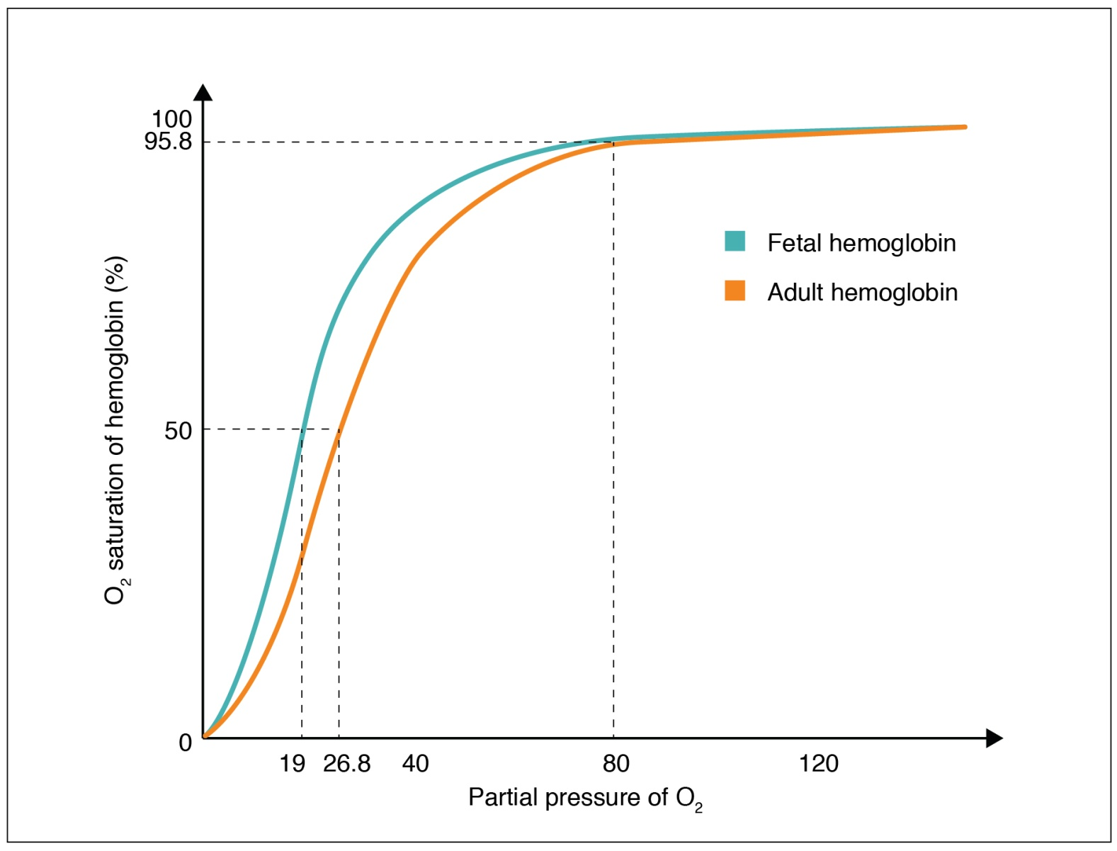
O2 Hb dissociation curve

Slide 10
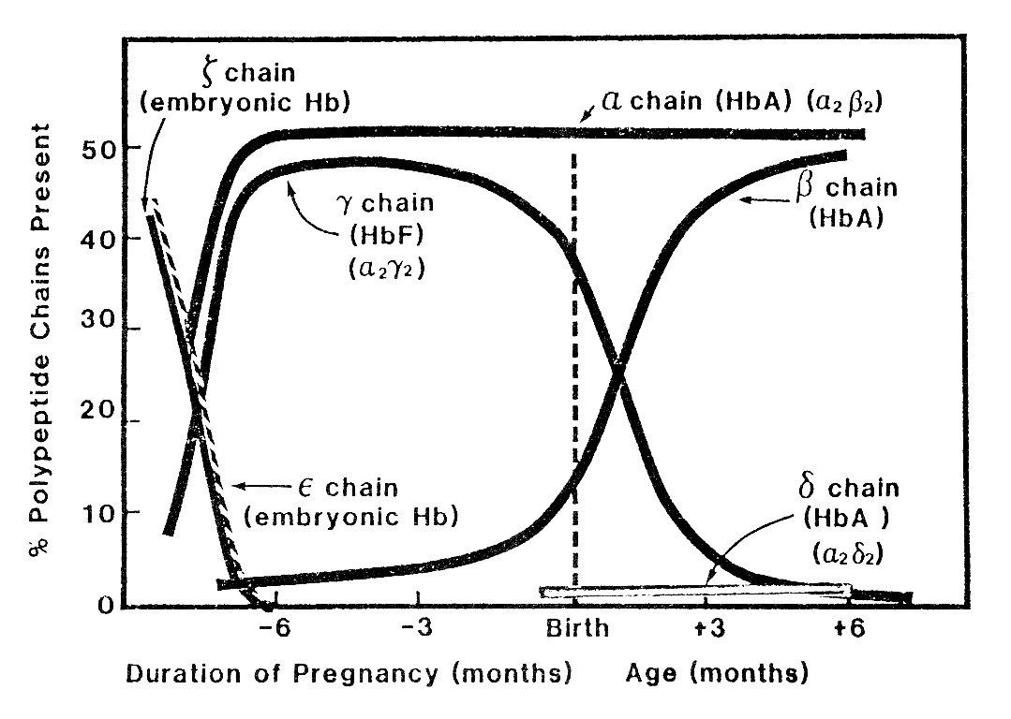
Haemoglobin synthesis in foetus and neonate

Slide 11
White blood cells
Neutrophils - bone marrow.
Lymphocytes and plasma cells are produced in lymphoid organs and the thymus.

Slide 12
Heart
Hear beats from the 4th week of gestation. (22 days)
Initially 65 beats per minute ( bpm) .
Nearing term 140 -160 bpm.
Autonomic nervous system control the fetal heart rate, stroke volume and BP.
First half of pregnancy-Sympathetic system
Second half – Parasympathetic system

Slide 13
CV parameters near term
HR 160bpm – 140bpm
BP 70/45 mmHg
Cardiac out put 350ml/min/kg
( adult 80ml/kg/min)
40% to placenta
13% to brain

Slide 14
Fetal circulation
Pulmonary circulation – high resistance
Systemic circulation – low resistance
3 important structures
Ductus venosus
Foramen ovale
Ductus arteriosus
Allows blood to bypass the liver and lungs.

Slide 15
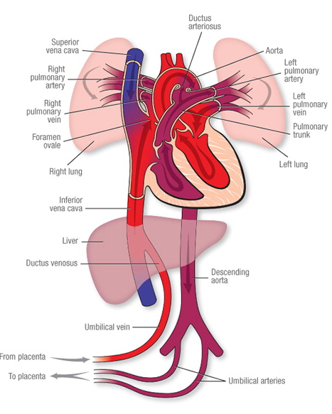
Vascular system
Ductus venosus –
Between the umbilical vein and the IVC.
Bypass the liver.
Foramen ovale-
Between the right and left atrium.
Allows blood from IVC to bypass the pulmonary circulation.
Ductus arteriosus-
Between the pulmonary artery and the descending aorta.
Bypass the lungs.

Slide 16
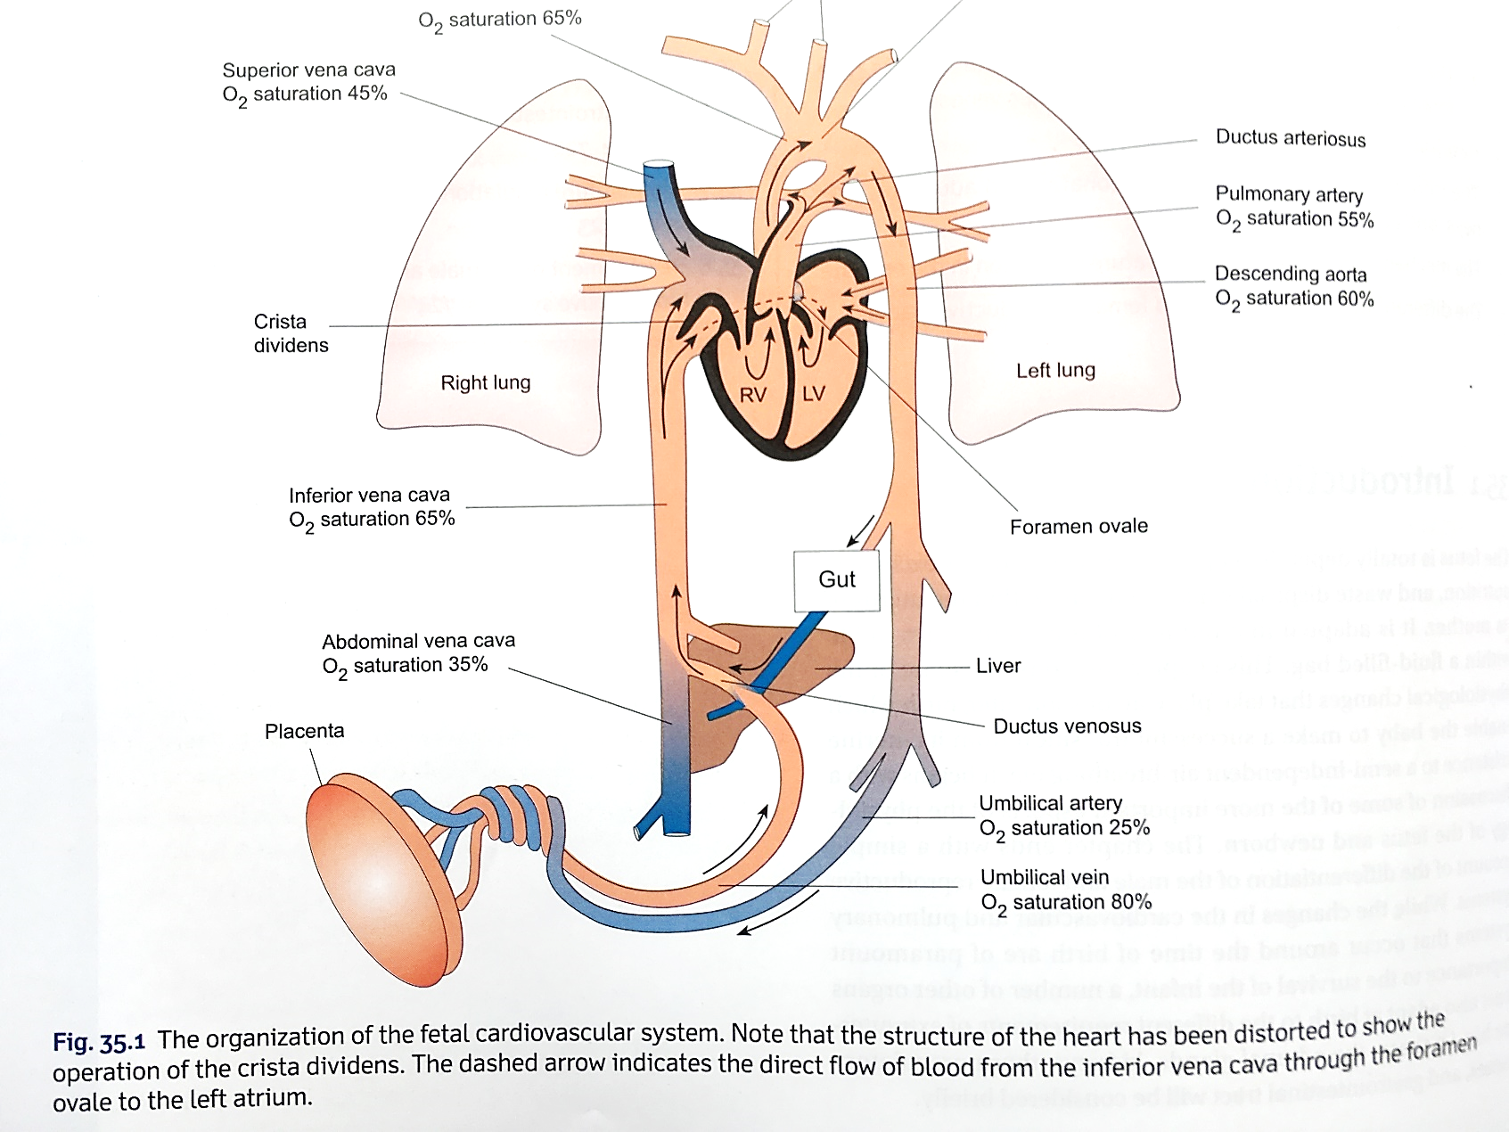
Fetal circulation

Slide 17
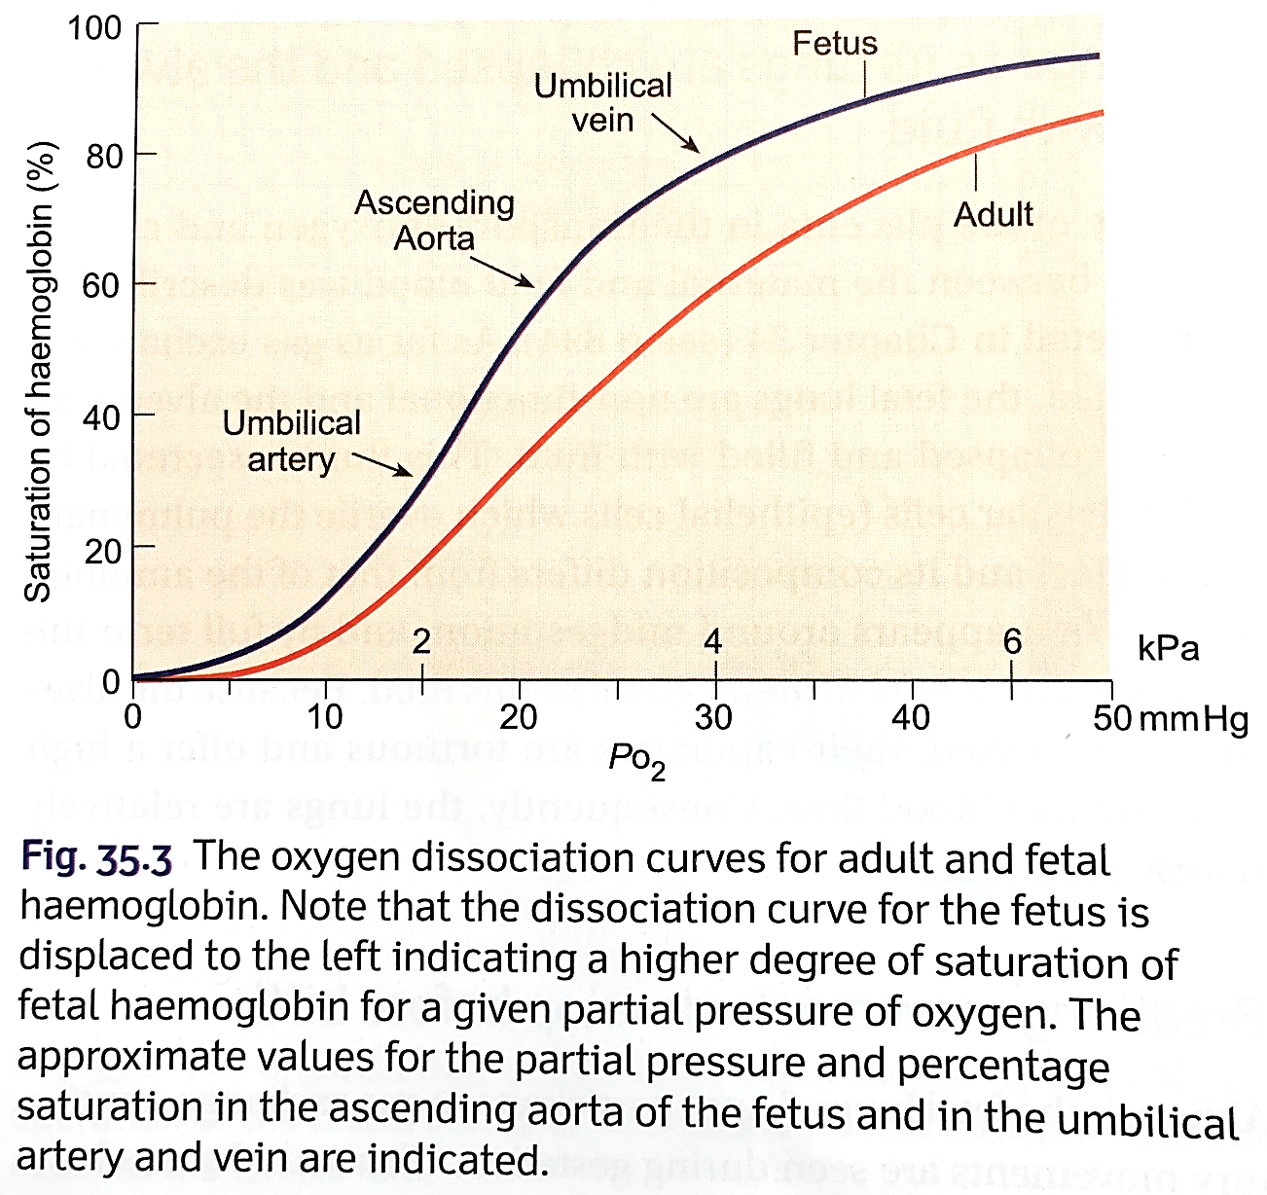
More oxygenated blood reach the brain, myocardium and adrenal glands.

Slide 18
Fetal circulation
Umbilical vein
Ductus venosus
IVC
RA
Foramen ovale
LA
Arteries of head and forearm
SVC
RA
RV
Pulmonary artery
Ductus arteriosus
Descending aorta
Umbilical artery
Placenta

Slide 19
Respiratory system
Placenta is the organ of respiration
End of 1st trimester- attempted respiratory movements
Tactile stimulation and asphyxia increase respiratory movements.
Last 3-4 months- respiratory movements are inhibited.
Lungs are deflated and filled with clear fluid.

Slide 20
Nervous system
Spinal reflexes are present by 3 months
Cortical functions are not mature even at birth.

Slide 21
Kidneys
Urine excretion starts by 2nd trimester
Regulation mechanisms not mature
Urine forms a part of amniotic fluid (70-80%)
Abnormal or absent kidney will result in reduced amniotic fluid.

Slide 22
Fetal GIT
12 weeks – swallows amniotic fluid
Able to absorb fluid
Forms meconium
Absorption of nutrients is limited
Nutrition through the placenta
During hypoxia sphincters relax and release meconium into the amniotic fluid – result in meconium aspiration at birth.

Slide 23
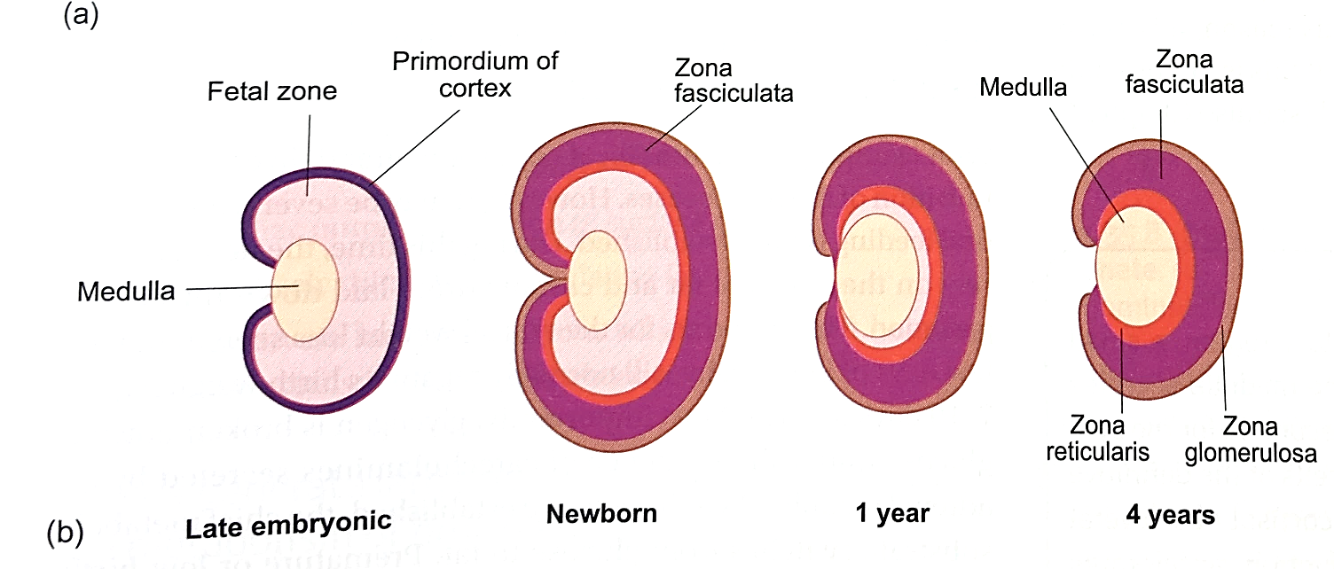
The fetal adrenal gland
Contain medulla, zoned cortex, and a fetal zone.

Slide 24
The fetal adrenal gland
Medulla secret catecholamine
Fetal zone is important for placental oestrogen synthesis
Cortex converts progesterone to cortisol.

Slide 25
Neonate
From birth to 1 month.
Period of adaptation to the life outside the womb.
At birth
Placental support with drawn.
Loose respiratory and metabolic support.

Slide 26
Breathing
The first and immediate step in the process of adjustment
Begins immediately after birth
Achieve a normal rhythm in 1 minute
Stimulated by relative hypoxia, cold exposure and tactile stimulation.
Neonates tolerate hypoxia for longer than adults ( 10 mins vs 4 mins)

Slide 27
Lung expansion
Volume (ml)
40
Alveoli are collapsed at birth and are filled with fluid. Has a high surface tension.
A large negative intra-pleural pressure is created with the first breath (60 mmHg)
Once the alveoli are opened less effort is needed to maintain it and continue breathing.
Surfactant help in keeping the alveoli open
+40 +20
0
-20 -40 -60
Intrapleural pressure (cm water)
Volume (ml)
40
+40 +20
0
-20 -40 -60
Intrapleural pressure (cm water)
Volume (ml)
40
+40 +20
0
-20 -40 -60
Intrapleural pressure (cm water)

Slide 28
Respiratory rate ( RR) – 40 cycles per minute
Tidal volume – 16ml
Minute respiratory volume – 640ml ( x2 of adult/BW)
Functional Residual Capacity is ½ of the adult/BW
Variations in the RR causes changes in blood gas levels.
Irregular breathing during REM sleep

Slide 29
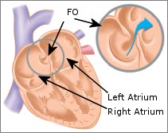
Circulation
Adult circulatory pattern is established with in hours.
Closure of foramen ovale
Umbilical vessels clamped
Right heart venous return drop
Pulmonary pressure decrease
RV pressure decrease
Systemic vascular resistance increase
LV pressure increase
Right atrial pressure
Left atrial pressure
LA>RA pressure
Flap over Foramen ovale close

Slide 30
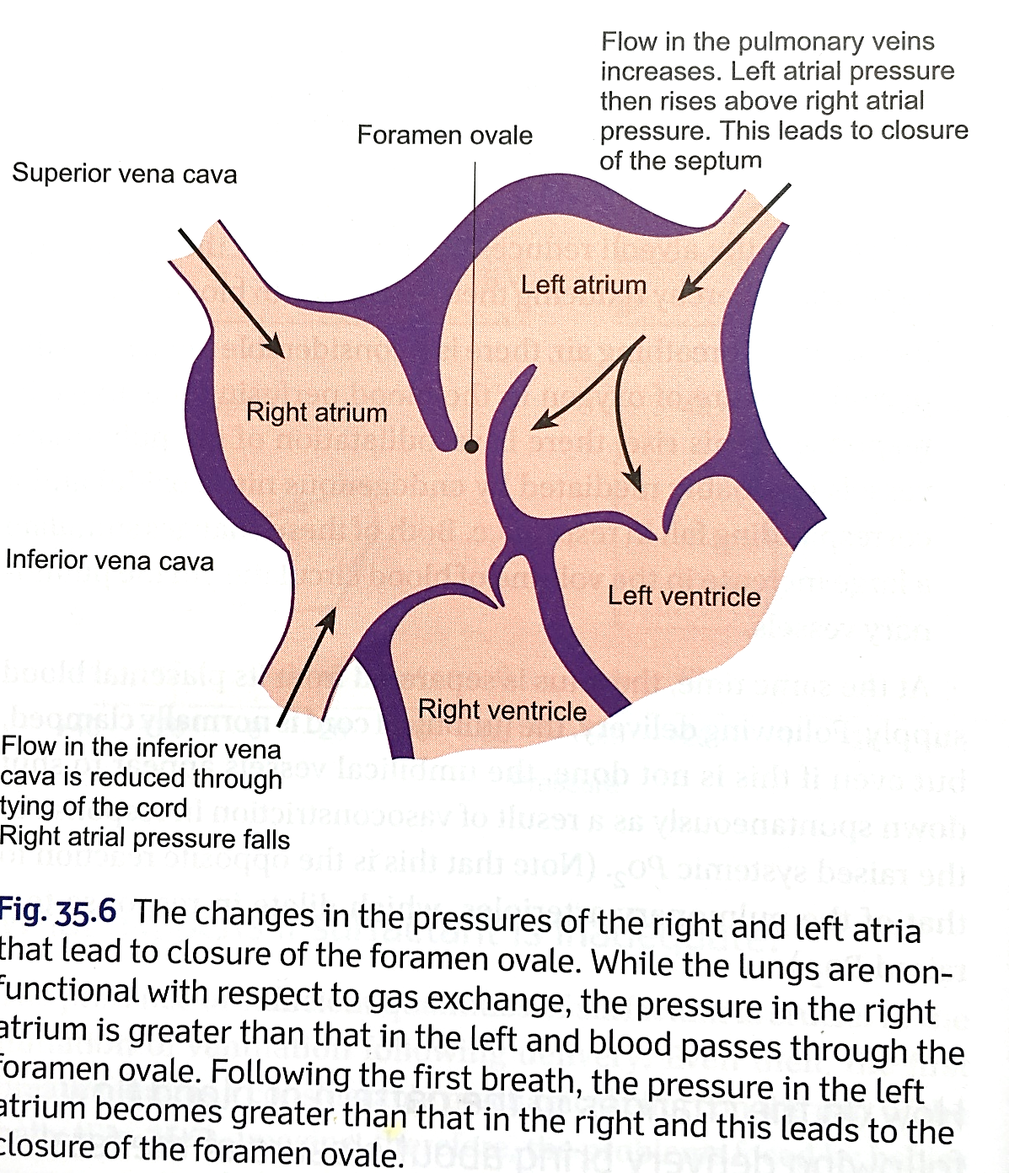

Slide 31
Closure of ductus arteriosus
Pulmonary arterial resistance decrease
Increase blood flow through pulmonary arteries
Pulmonary pressure less than systemic pressure
Reverse flow through the ductus arteriosus
Higher oxygen content in blood Functional closure in 1-8 days
Anatomical closure by fibrosis in 1-4 months

Slide 32
Closure of ductus venosus
Mechanism not known
Persist as ligamentum venosum
Non closure is never seen
Increase in portal pressure force blood through the liver sinusoids.

Slide 33
Circulation
Cardiac output is grater per body weight than an adult ( 500ml/min)
Low BP ( 70/90mmHg) – reach adult levels only in adolesence

Slide 34
Circulation
Blood volume depend on the duration of placental separation.
Higher RBC, WBC and Hb levels.
RBC reduce in 6-8 weeks as the hypoxic stimulus is lost

Slide 35
Liver
Bilirubin conjugation not mature – Physiological jaundice.
Hepatic gluconeogenesis is not optimal – risk of hypoglycemia.
Formation of plasma proteins deficient – plasma protein concentration falls.
Deficient production of factors for blood coagulation

Slide 36
Metabolism
Twice as great Basal metabolic rate in relation to body weight than an adult
Stored fats and proteins are used for energy until feeding.
10% weight loss in the first 2-3 days.
Most is due to loss of fluid.

Slide 37
GIT and Nutrition
Breast milk provides the optimal levels of nutrients
Further more BM provides immunity and enzymes aid in absorption
Absorption of starch and fat is less.
(Cows milk contain high fat levels - less tolerated)
Vit K levels are low – supplemented to prevent bleeding following birth trauma.
Fe²⁺ , Vit D and Ca²⁺ are specially needed during the neonatal period.

Slide 38
Kidneys
High fluid turnover
Risk of dehydration
Regulation of electrolytes and acid base balance not well developed
Risk of acidosis with the high metabolic rate

Slide 39
CNS
Spinal cord and brain stem function are present
Cortical functions not fully developed
Myelination of tracts continue into childhood

Slide 40
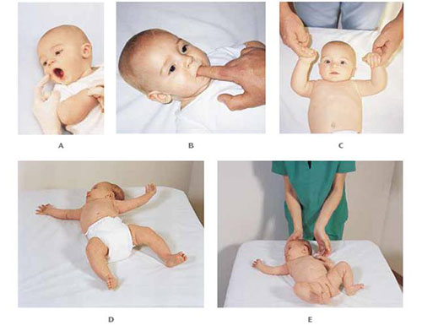

Slide 41
Immunity
Immunity is less in a neonate. Maternal antibodies that crossed the placenta provide protection for a few months.
Allergy only develop when the infants own antibodies begin to form.

Slide 42
Temperature regulation
Neonates have a higher surface area so the risk of hypothermia is high as Higher surface area to volume
Higher cardiac output to surface area
A thin (comparatively) layer of insulating fat
A large head (comparatively)
Temperature regulation mechanisms are not well established.

Slide 43
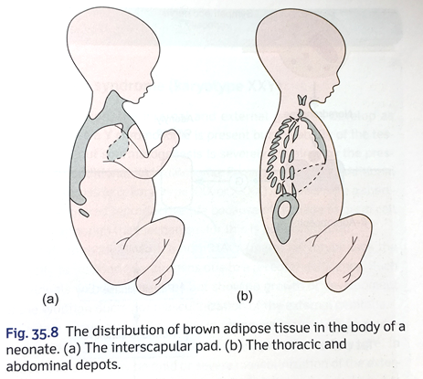
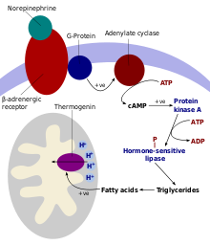
Secret weapon – Brown adipose tissue
COLD STERESS
Catecholamine secretion

Slide 44
Refer
Premature infant

Slide 45


Slide 46
Summary
Fetus
Growth and development
Cardiac and circulatory adaptations to intrauterine life
Neonate
Immediate changes in Cardio respiratory systems to extra uterine life
Continued maturation of the organ systems

